Slide 1
Annual Return in GST

Slide 2
Areas to be covered in this seminar
Introduction
Filing of Annual Return…. GSTR 9
Filing of Annual Return …. GSTR 9A

Slide 3
Amendments in GST Returns

Slide 4
Amendments in GST returns
Amendment ……. GSTR 1
Amendment ……. Circular No: 26
Amendment ……. Pay through ….. DRC 03
Amendment ……. GSTR 9/9A
Amendment ……. GSTR 9C

Slide 5
Errors in ITC

Slide 6
Errors in ITC
ITC …………………not taken
ITC …………………Excess taken
ITC …………………wrong tax taken as ITC
ITC …………………Ineligible ITC taken
ITC …………………Ineligible ITC not disclosed in 3B

Slide 7
ITC ….. Various scenarios

Slide 8
ITC….Various scenarios
ITC …………………Taken in same year or next year
ITC …………………Taking ITC Only through GSTR 3B
ITC …………………DRC 03…. Only a last Resort
ITC …………………Cannot be taken through Annual Returns
ITC ………………… updation in 2A after time limit
ITC ………………… Not reflected in 2A
ITC ………………… Not our ITC, but reflected in our 2A

Slide 9
Outward supply ….. Various scenarios

Slide 10
Outward Supply….Various scenarios
Taxable Sales……………………..omitted in 3B/ GSTR 1
Exempted Sales ………………….omitted in 3B/GSTR 1
Excess Taxable or Exempted Sales…… in 3B or GSTR 1
Sales……………………………… wrongly sales bills issued.
Sales……………………………… wrongly reported in 3B/GSTR 1
Sales…………………………….. B2B…..reported as B2C.
Sales ….increase through….. 3B/GSTR 1/Annual Returns/GST Audit/DRC 03
Correction……………………. In same year or next year….

Slide 11
Annual Return in GST

Slide 12
Data of FY 2017-18
Reported in 2017-18
Reported in 2018-19
3B
GSTR 1
3B
GSTR 1
GSTR 9 (Annual Return)
Table 10,11,12,13

Slide 13
What is new in Annual Returns?

Slide 14
What is new in Annual Returns?
It is mandatory to file GSTR1 and GSTR 3B ……… before fling GSTR 9
It is mandatory to file GSTR1 and GSTR 3B & GSTR 9…. Before filing 9C
Additional liability can be declared through ……… 9/9A.
Additional ITC……………………………… cannot be claimed through GSTR 9
HSN for inward supply……… only if ……value independently account for 10% or more of total value of inward supplies…..
Additional liability…….in 9/9A….. Can be paid through DRC 03…… only through cash

Slide 15
Points to Note
Filing of NIL Annual Return is mandatory.
Annual Return cannot be revised.
Annual Return is compulsory even if Registration is cancelled.
If a Regd Person was Regular and Composition dealer……. File both 9+ 9A
If a person has different GSTIN, File separate Annual Return for each GSTIN.
Handbook on GST Annual Return Released by ICAI recently.
Technical Guide on GST Audit will be released soon by ICAI.
Draft Handbook on Accounting Treatment under GST from ICAI
New Return filing system……Expected from 1st July, 2019

Slide 16
Consequences of failure to file
Annual Return in GST

Slide 17
Consequences of failure to file Annual Return
Notice to Defaulters…. u/s 46
Late Fees for Delayed Filing
General Penalty…. Upto 50,000

Slide 18
New Facilities in GST Portal

Slide 19
New facilities in GST Portal
Download……… GSTR 3B Summary.
Download……… GSTR 1 Summary.
Download……… GSTR 9 System Computed Summary.
Verify……… Total Credit & Liability Statement.
Verify……… Liability (Other than Export & RCM).
Verify……… Liability …. Due to RCM.
Verify……… Liability ….. Due to Exports.
Verify……… ITC Credit claim and Due.

Slide 20
New facilities in GST Portal

Slide 21
New facilities in GST Portal

Slide 22
New facilities in GST Portal

Slide 23
Annual Return – Normal

Slide 24
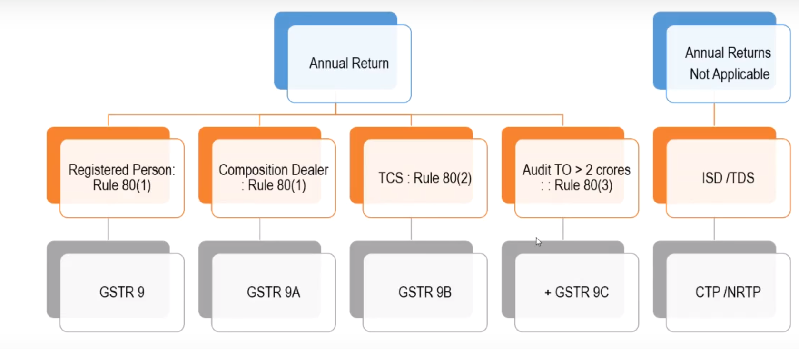

Slide 26
Annual Return –
Manual Compilation areas

Slide 27
Table 5F – Non GST Supply
Table 6 – ITC Availed Bifurcation
Table 7 – ITC Reversal Bifurcation
Table 8 – GSTR 2 A Reconciliation + ITC Eligible/Ineligible
Table 10 to 14 – Previous Year Data, Reported in CY Returns
Table 15 – Other Information – Demand & Refunds
Table 16 – Inward Supply from Composition dealer/ Deemed Supply

Slide 28
Table 17 – Rate of Tax for HSN outward Supplies
Table 18 – HSN Details of inward supplies subject to 10% Crieterion

Slide 29
How Annual Return is prepared?

Slide 30
Data from ….GSTR 3B (RCM, ITC, Tax Paid Details)
Data from ….. GSTR 1 (Supply Details…..)
Data filled by Tax Payer manually…. (Breakeup of ITC, Corrections, ….)

Slide 31
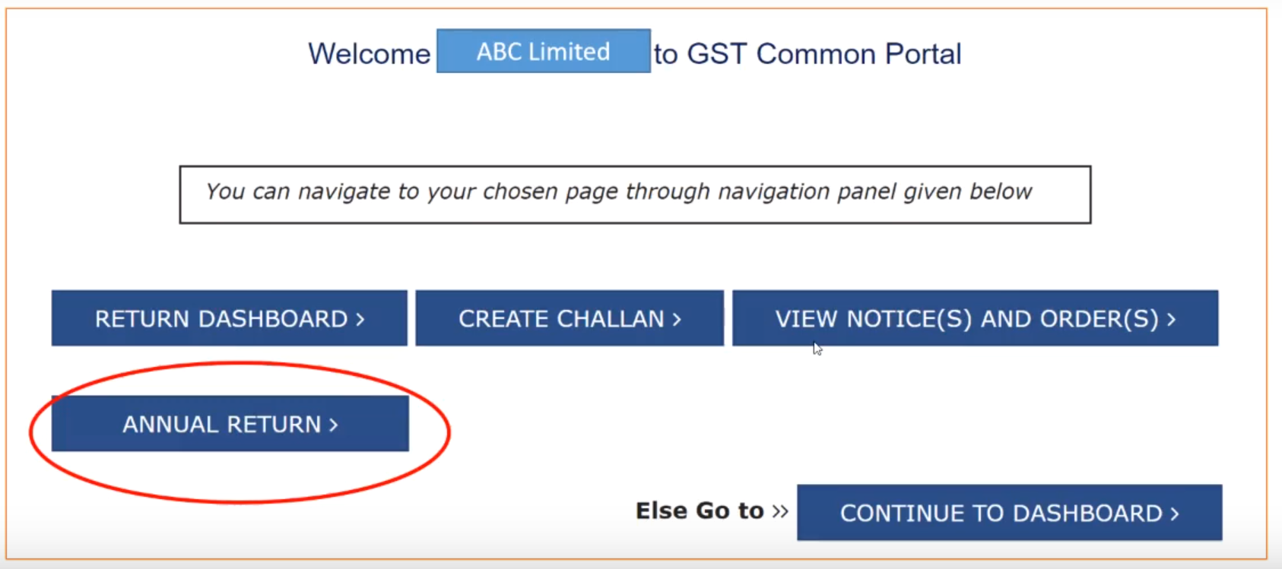

Slide 32
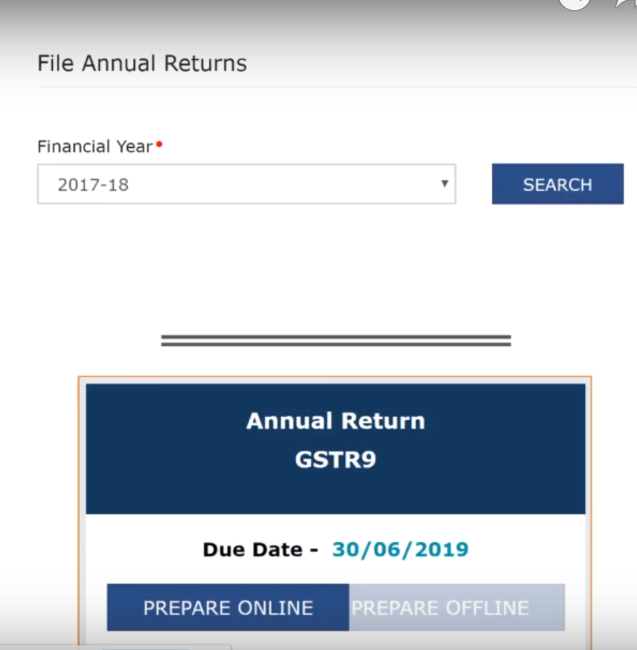

Slide 39
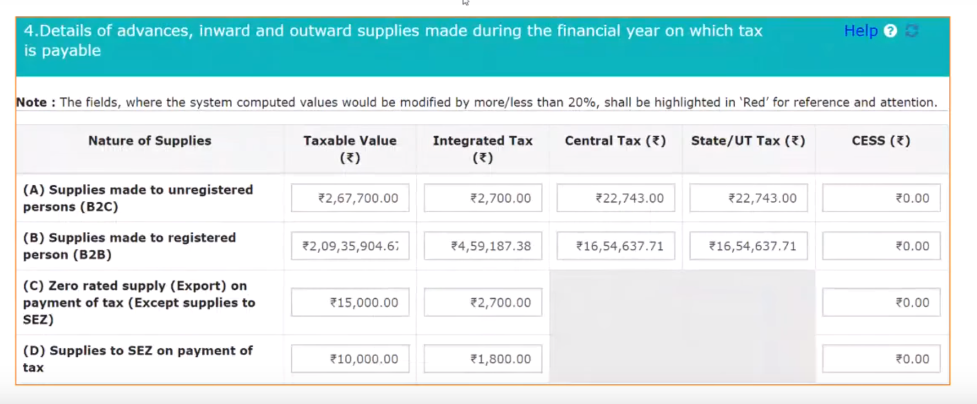

Slide 42
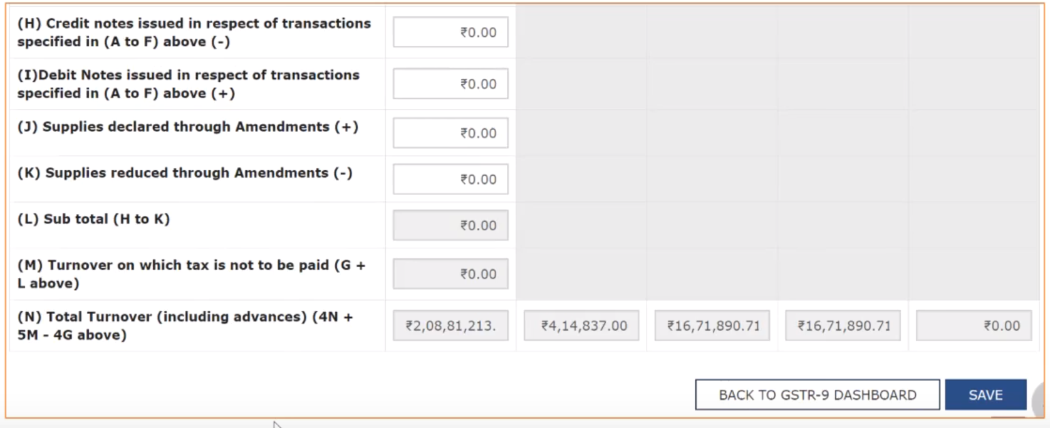

Slide 59
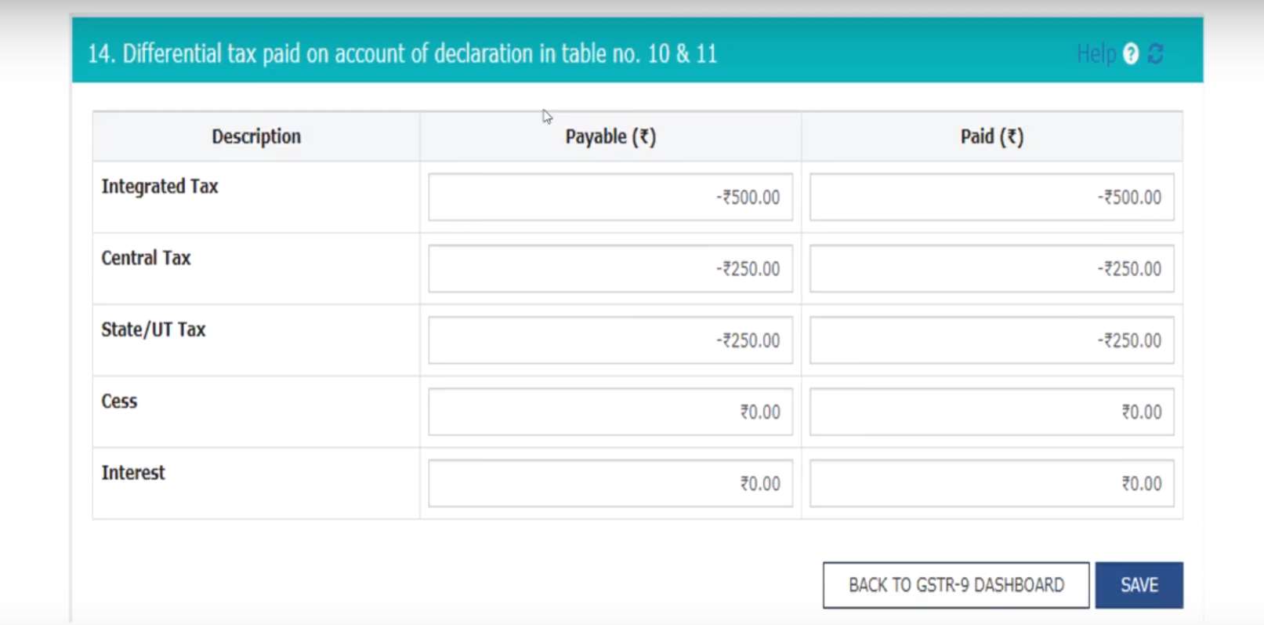

Slide 61
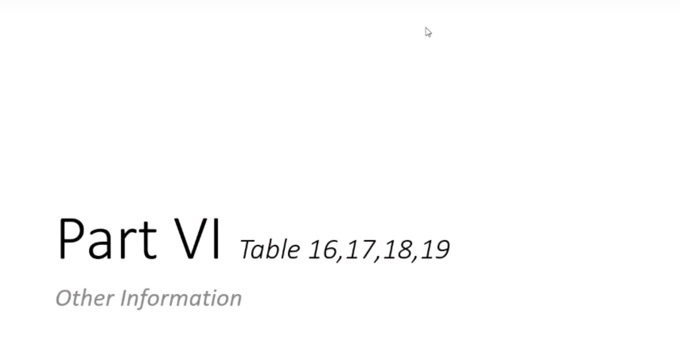

Slide 68
Annual Return in GST

Slide 70
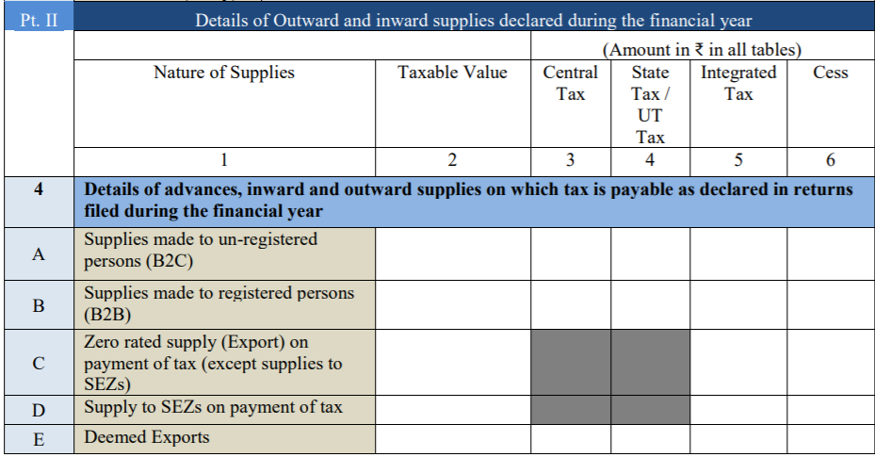

Slide 71
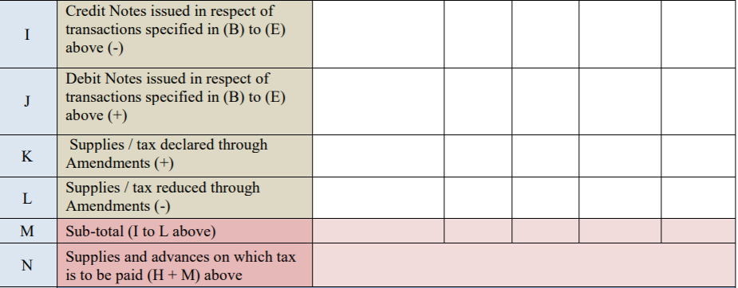

Slide 72
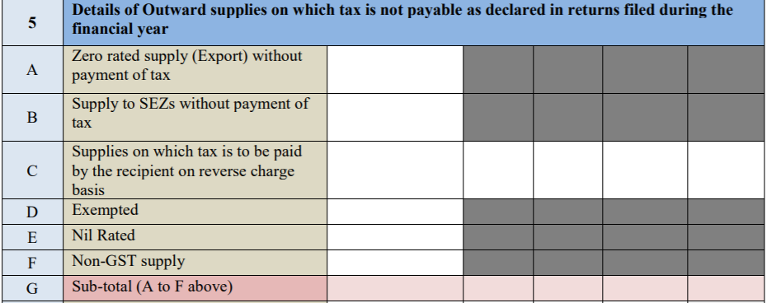

Slide 73
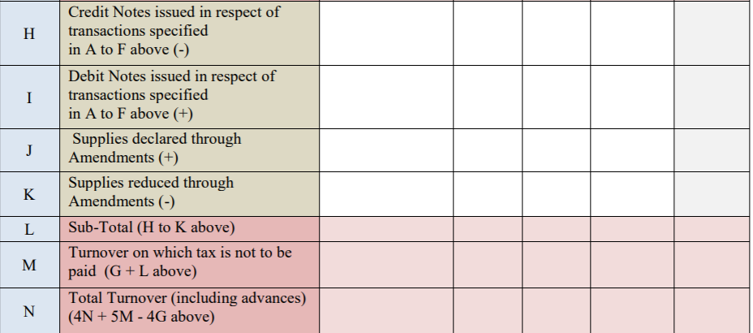

Slide 74
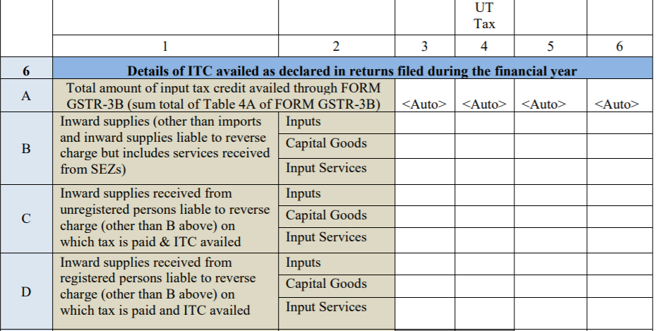

Slide 75
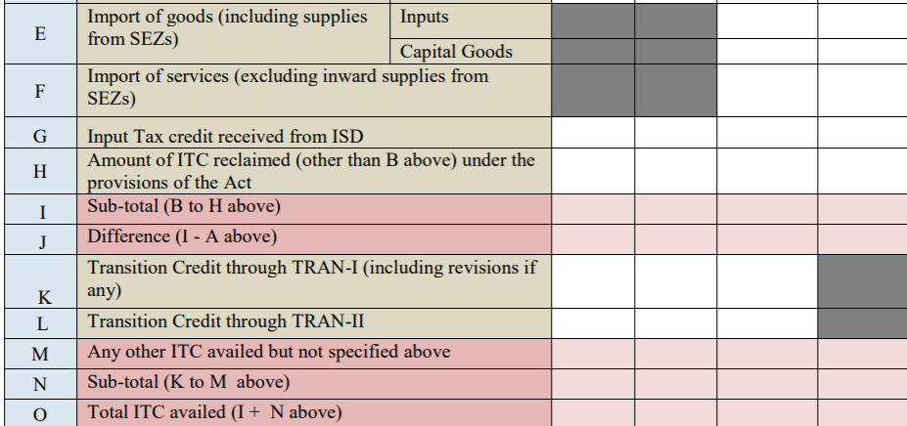

Slide 76
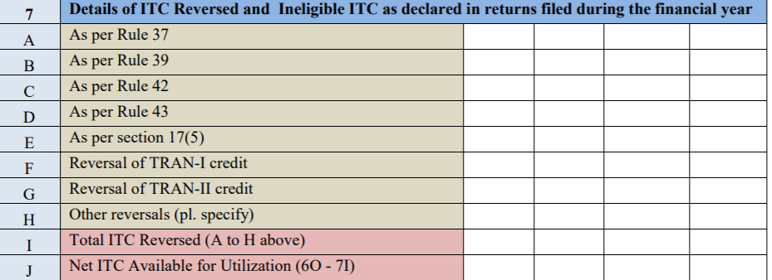

Slide 77
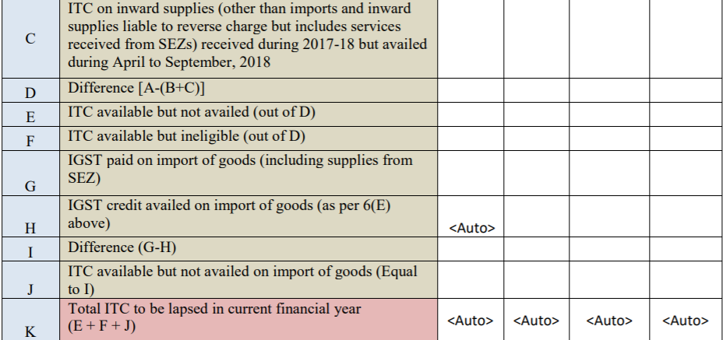

Slide 78
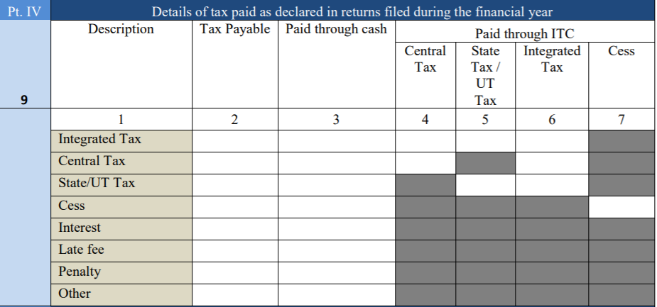

Slide 79
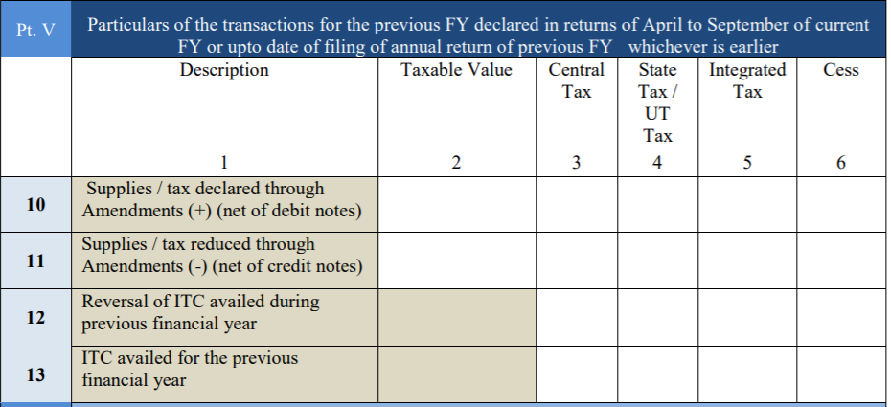

Slide 81
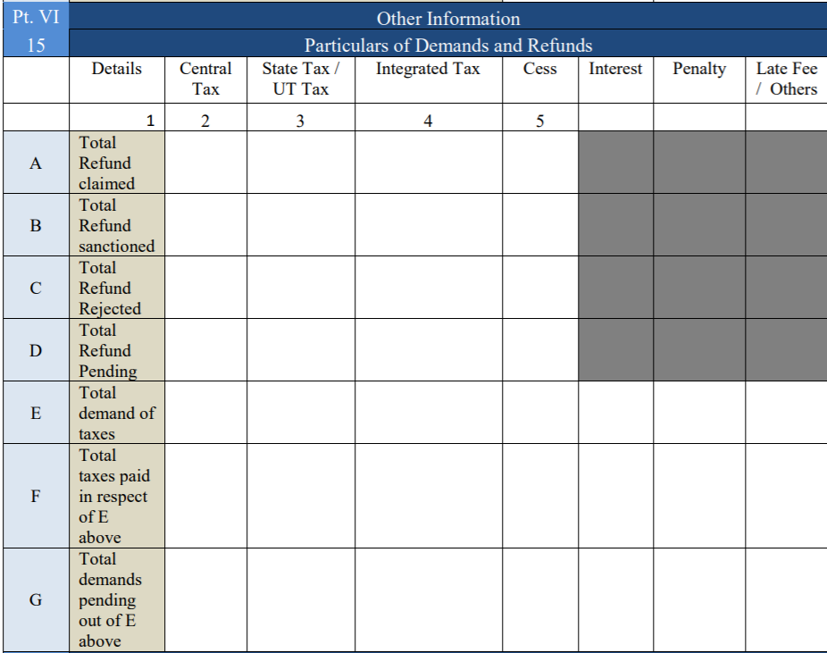

Slide 82
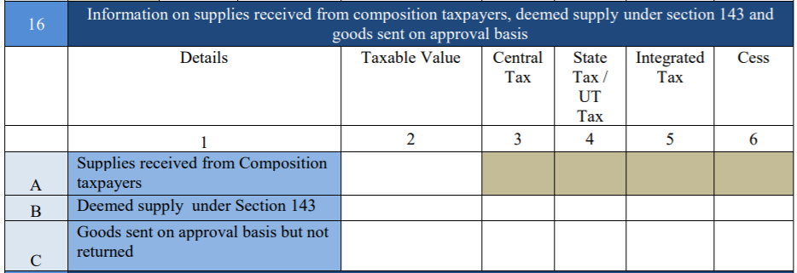

Slide 84
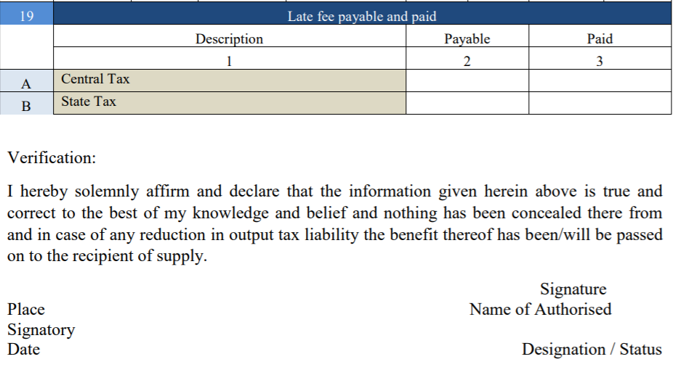

Slide 85
Annual Return – Composition

Slide 86
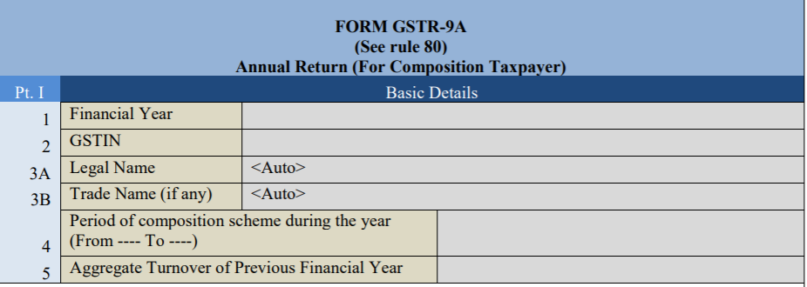

Slide 88
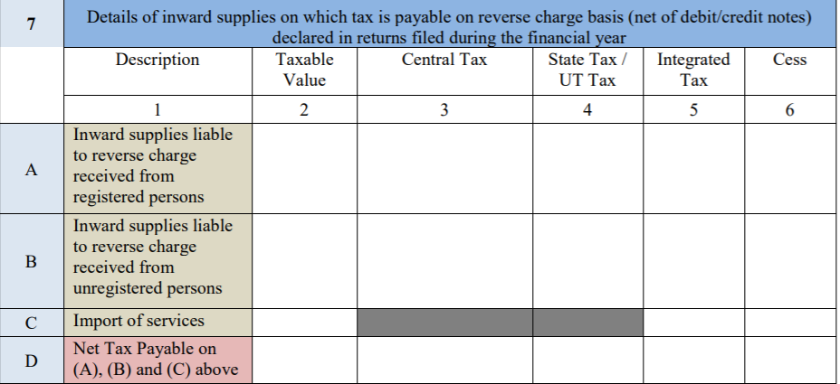

Slide 91
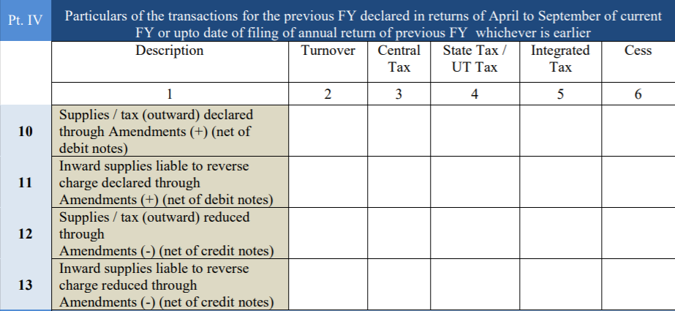

Slide 93
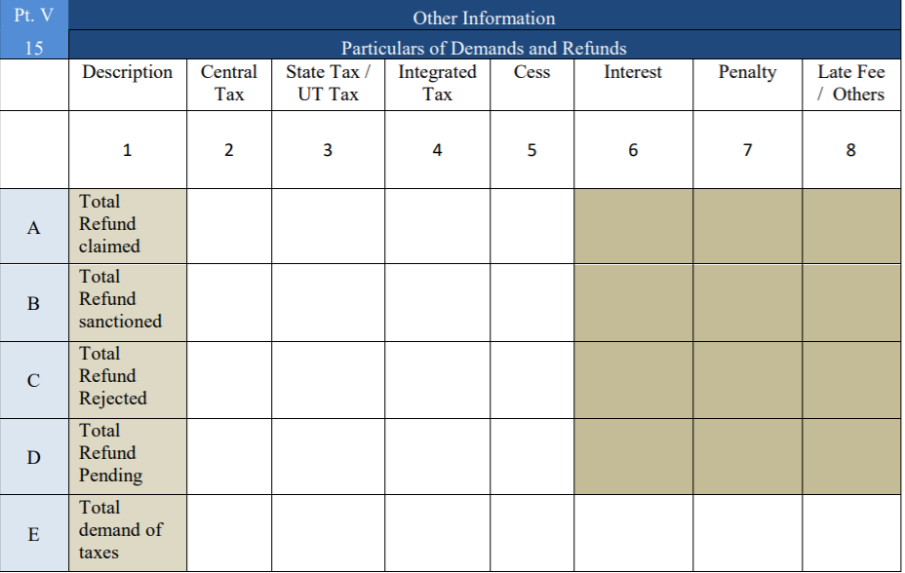

Slide 95
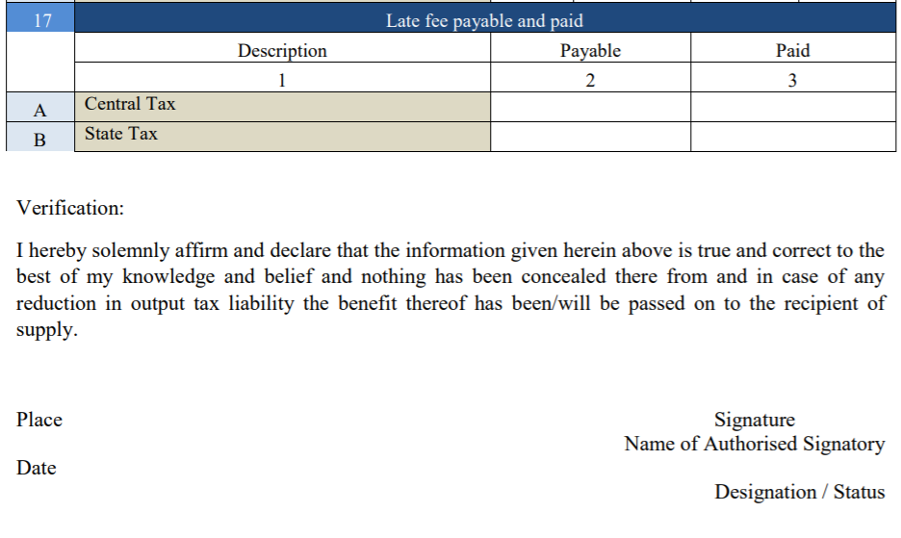

Slide 96
Thank You

